Slide 1
Status and FLAGS Register (Ch-5)
Flow Control Instructions (Ch-6)
Logic, Shift and Rotate Instructions (7)
Multiplication and Division Instructions (9)

Slide 2
Processor Status and FLAGS Register

Slide 3
FLAGS Register
Individual bits control the action or represent the status of the processor
Control flags (TF, IF, DF)
Determine how the processor responds to certain situations
Status flags (CF, PF, AF, ZF, SF, OF)
Set to represent the result of certain operations
Used to control conditional jump instructions

Slide 4
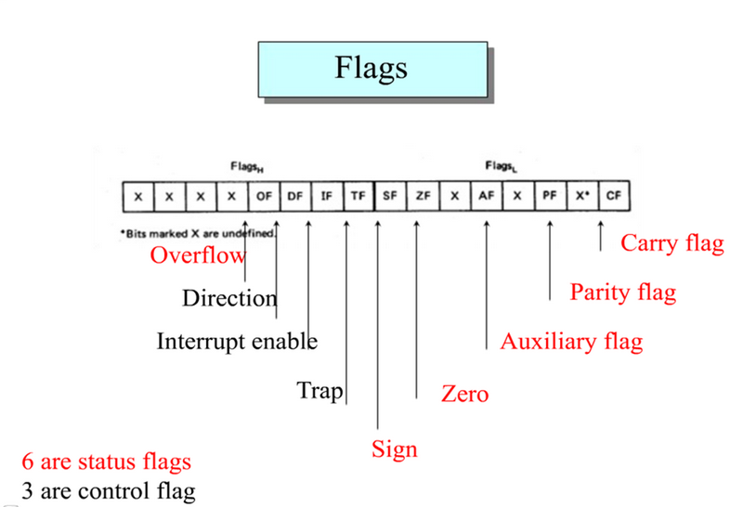

Slide 5
Control Flags
DF - Direction flag [String access direction]
STD: direction = down
CLD: direction = up
IF - Interrupt enable
STI: enable external interrupts
CLI: disable maskable external interrupts
TF - Trace flag
Interrupt 1 after executing instruction, if set

Slide 6
Status Flags
The Carry Flag (CF) CF = 1 if there is a carry out from the msb (most significant bit) on addition, or there is a borrow into the msb on subtraction
CF = 0 otherwise
CF is also affected by shift and rotate instructions
The Parity Flag (PF) PF = 1 if the low byte of a result has an even number of one bits (even parity)
PF = 0 otherwise (odd parity)

Slide 7
Status Flags
The Auxiliary Carry Flag (AF) AF = 1 if there is a carry out from bit 3 on addition, or there is a borrow into the bit 3 on subtraction
AF = 0 otherwise
AF is used in binary-coded decimal (BCD) operations
The Zero Flag (ZF) ZF = 1 for a zero result
ZF = 0 for a non-zero result

Slide 8
Status Flags
The Sign Flag (SF) SF = 1 if the msb of a result is 1; it means the result is negative if you are giving a signed interpretation
SF = 0 if the msb is 0
The Overflow Flag (OF) OF = 1 if signed overflow occurred
OF = 0 otherwise

Slide 9
(Signed) Overflow
Can only occur when adding numbers of the same sign (subtracting with different signs)
Detected when carry into MSB is not equal to carry out of MSB
Easily detected because this implies the result has a different sign than the sign of the operands
Signed Overflow Example
10010110 + 10100011 00111001
Carry in = 0, Carry out = 1 Neg+Neg=Pos Signed overflow occurred OF = 1 (set)
00110110 + 01100011 10011001
Carry in = 1, Carry out = 0 Pos+Pos=Neg Signed overflow occurred OF = 1 (set)

Slide 10
Unsigned Overflow
The carry flag is used to indicate if an unsigned operation overflowed
The processor only adds or subtracts - it does not care if the data is signed or unsigned!
10010110 + 11110011 10001001
Carry out = 1 Unsigned overflow occurred CF = 1 (set)

Slide 11
Instructions and Flags
MOV and XCHG - no flags are changed
ADD and SUB - all flags affected
INC and DEC - all except CF
NEG - all flags affected
CF=0 only if value is 0

Slide 12
Flow Control Instructions

Slide 13
Flow Control Instructions
Jump and Loop instructions transfer control to another part of the program.
The transfer can be unconditional or can depend on status flags.

Slide 14
Flow Control Instructions
Conditional jumps:
Jxxx destination label;
Destination label must precede the jump instruction by no more than 126 bytes, or follow it by no more than 127 bytes
Machine Code= Opcode Bytes
7x yy

Slide 15
Conditional jumps
The CMP instruction:
CMP destination, source
CMP ax,bx ; ax=7FFFh, bx=0001h
; ax-bx = 7FFFEh
JG Below; STATUS: ZF=SF=OF=0
Add bx,cx
....
Below:
….

Slide 16
Signed Vs Unsigned Jumps
;ax=7FFFh, bx= 8000h
CMP ax,bx
JA BELOW ; incorrect in a signed sense

Slide 17
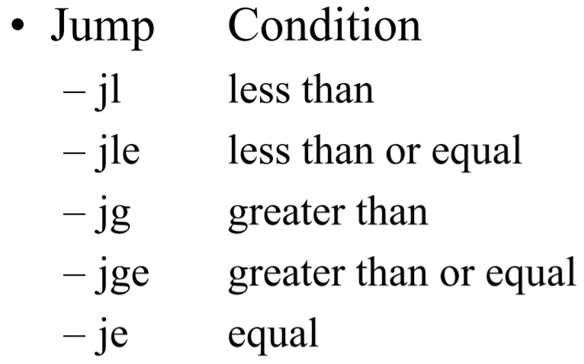
Signed Jumps

Slide 18
Signed Jumps

Slide 19
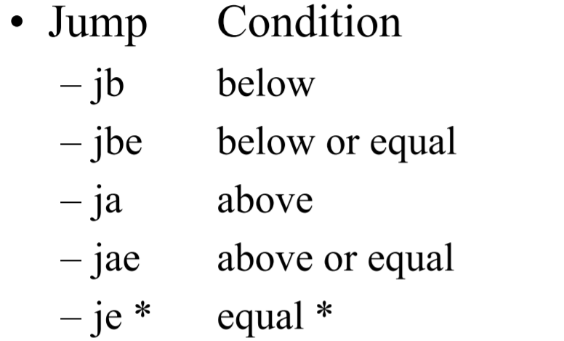
Unsigned Jumps

Slide 20
Branching Structures
IF-THEN
IF-THEN-ELSE
CASE
AND conditions
OR conditions

Slide 21
IF-THEN-ELSE structure
mov ah, 2 ; prepare for display ; if al <= bl cmp al, bl ; al <= bl ? jnbe else_ ; no, display bl ; then ; al <= bl mov dl, al ; move it to dl jmp display
else_: ; bl < al
mov dl, bl
display: int 21h ; display it ; endif
if al <= bl then display the character in al else display the character in bl endif

Slide 22
The CASE structure
; case ax
cmp ax, 0 ; test ax jl neg ; ax < 0 je zero ; ax = 0 jg pos ; ax > 0
neg: mov bx, -1 jmp endcase
zero: mov bx,0 jmp endcase
pos: mov bx, 1 ; put 1 in bx
endcase:
case
ax < 0 : put -1 in bx = 0 : put 0 in bx > 0 : put 1 in bx
endcase

Slide 23
Looping Structures
FOR loop
WHILE loop
REPEAT loop
Loop structure:
Top:
;loop body
Loop Top
CX contains the loop counter

Slide 24
FOR Loop
a counter-controlled loop to display a row of 80 stars
mov cx,80 ; # of stars mov ah,2 ; disp char fnctn mov dl,'*' ; char to display
jcxz end_
TOP:
int 21h ; display a star loop TOP ; repeat 80 times
end_:

Slide 25
A Loophole
The FOR loop implemented with the loop instruction always executes at least once
If cx = 0 at the beginning, the loop will execute 65536 times!
To prevent this, use a jcxz before the loop
jcxz SKIP
TOP:
; body of loop . . . loop TOP
SKIP:

Slide 26
WHILE LOOP
Count the number of characters in an input line
mov dx,0 ;DX counts chars mov ah,1 ;read char int 21h ;read char into al
WHILE_:
cmp al,0Dh ;ASCII CR? je ENDWHILE ;yes, exit inc dx ;not CR, inc count int 21h ;read another char jmp WHILE_ ;loop back
ENDWHILE:
count = 0 read char while char <> carriage_return do
Increment count read char
endwhile

Slide 27
REPEAT LOOP
repeat
read character
until character is a blank
mov ah,1 ;read char function
REPEAT:
int 21h ;read char into al
;until
cmp al,' ' ;a blank? jne REPEAT ;no, keep reading

Slide 28
Your turn..
Convert into pseudocode:
cmp ax,bx
jl a0 ; ax<bx
cmp bx,cx
jge c0 ;bx>=cx
mov bx,0 ;bx<cx
jmp end_
c0:
mov cx,0 ; cx=0
jmp end_
a0:
mov ax,0 ;ax=0
end_: ; end of code

Slide 29
Your turn..
Convert into pseudocode:
if (ax<bx) ax=0
else{
if(bx<cx) bx=0
else cx=0
}

Slide 30
AND conditions
; read a character
mov ah, 1 ;prepare to read
int 21h ;char in al
; if char >= 'A' and char <= 'Z'
cmp al,'A' ;char >= 'A'? jnge endif ;no, exit cmp al,'Z' ;char <= 'Z'? jnle endif ;no, exit
;then display character
mov dl,al ;get char mov ah,2 ;prep for display int 21h ;display char
endif:
read a character into al if char >= 'A' and char <= 'Z' then
display character
endif

Slide 31
IF-THEN structure
; if ax < 0 cmp ax, 0 ; ax < 0 ? jnl endif ; no, exit ; then neg ax ; yes, change sign endif:
Example -- to compute |ax|:
if ax < 0 then ax = -ax endif

Slide 32
Multiplication and Division Instructions

Slide 33
Multiplication instructions
imul source
Signed multiply
mul source
Unsigned multiply
Byte and Word Multiplication (A X B)
If two bytes are multiplied, the result is a 16-bit word
A: source
B: al
product: ax
If two words are multiplied, the result is a 32-bit doubleword
A: source
B: ax
Product (ms 16 bits): dx
Product (ls 16 bits): ax

Slide 34
Multiplication instructions
source can be a register or memory location (not a constant)
Byte form
AX=AL*source
Word form
DX:AX=AX*source
CF/OF
MUL
0: upper half result 0
IMUL
0: if upper half is sign extension of lower half.
If ax contains 0001h and bx contains FFFFh
mul bx; dx = 0000h ax = FFFFh
imul bx ; dx = FFFFh ax = FFFFh (-1)
SF, ZF, AF, and PF
Undefined

Slide 35
More Examples
AX=FFFFh,BX=FFFFh
Instruction | Hex Product | DX | AX | CF/OF
MUL BX | FFFE0001 (4294836225) | FFFE (!zero) | 0001 | 1
IMUL BX | 1 | 0000 | 0001 | 0
AL=80h,BL=FFh
Instruction | Hex Product | AH | AL | CF/OF
MUL BL | 7F80 (32640) | 7F(!zero) | 80 | 1
IMUL BL | 0080 | 00 (no sign extension) | 80 | 1

Slide 36
Division instructions
cbw
convert byte to word
cwd
convert word to doubleword
div source
unsigned divide
idiv source
signed divide

Slide 37
Byte and Word Division (A/B)
When division is performed
two results: the quotient and the remainder
Quotient and remainder are same size as the divisor
For the byte form,
Divisor, B: source ;Dividend , A: ax
Quotient :al ;Remainder: ah
For the word form,
Divisor, B: source ;Dividend , A: dx:ax
Quotient :ax ; Remainder: dx

Slide 38
An Example
;If dx = 0000h, ax = 0005h, and bx = FFFEh (-2)
div bx; ax = 0000h dx = 0005h
idiv bx; ax = FFFEh dx = 0001h

Slide 39
Divide Overflow
It is possible that the quotient will be too big to fit in the specified destination (al or ax)
if the divisor is much smaller than the dividend
the program terminates and the system displays the message "Divide Overflow"

Slide 40
Sign Extension of the Dividend
Word division
The dividend is in dx:ax even if the actual dividend will fit in ax
For div, dx should be cleared
For idiv, dx should be made the sign extension of ax using cwd
e.g. -1250/7
MOV AX,-1250
CWD ; sign extend
MOV BX,7
IDIV BX

Slide 41
Sign Extension of the Dividend
Byte division
The dividend is in ax even if the actual dividend will fit in al
For div, ah should be cleared
For idiv, ah should be made the sign extension of al using cbw

Slide 42
Logic, Shift and Rotate
Boolean Data 0 or 1
Requires only a single bit
0 = FALSE
1 = TRUE
Boolean operators
Unary: NOT
Binary: AND, OR, XOR

Slide 43
Logic Instructions
and destination, source
Logical AND
can be used to clear specific destination bits
not destination
Logical NOT (one's complement)
or destination, source
Logical OR
can be used to set specific destination bits
test destination, source
Test bits
xor destination, source
Logical Exclusive OR
can be used to complement specific destination bits
selectively modify the bits
in the destination using
a bit pattern (mask)

Slide 44
Examples
To clear the sign bit of al while leaving the other bits unchanged,
01111111b = 7Fh (mask)
and al,F7h ;1111 0111
To set the MSB and LSB of al while preserving the other bits,
10000001b = 81h (mask)
or al,81h
To change the sign bit of dx,
8000h (mask).
xor dx,0FFFFh

Slide 45
Examples
Converting character to decimal:
Sub al, 30h ;Or
Sub al, 48 ; Or
AND ax, 000fh ;?? 0000 1111
32h = 0011 0010
2d = 0000 0010
How about reverse (decimal to character)??
Xor ax,ax ;ZF=1
Mov/xchg ax,0 ;ZF=unchanged

Slide 46
The TEST instruction
TEST destination, source
Performs AND, does not store result
Flags are set as if the AND were executed
Example
TEST CL, 10000001b ;cl=1111 1110 (7Eh) JZ EvenAndNonNegative ;jump if ZF=1 JS Negative ; jump if SF=1 ; must be odd and positive if it gets here

Slide 47
Bit Shifting
Slide bits in byte or word to left or right
What happens to bit that is shifted out?
It is copied into the CF
What bit value is shifted in?
SHR, SHL, SAL: =0
SAR: =sign bit
ROR, ROL: =bit shifted out
RCR, RCL: =CF

Slide 48
Left Shift Instructions
Shl
Zeros are shifted into the rightmost bit positions
last bit shifted out goes into CF
Effect on flags:
SF, PF, ZF reflect the result
AF is undefined
CF = last bit shifted out
OF = 1 if result changes sign on last shift
dh = 10001010, cl = 00000011
after shl dh,cl
dh = 01010000, cf = 0
What about of ?

Slide 49
The SAL instruction
shl :multiply an operand by powers of 2
sal(shift arithmetic left)
used in instances where multiplication is intended
Both instructions generate the same machine code!

Slide 50
Rotate
Rotate Instructions Rotate Left
rol (rotate left) shifts bits to the left
The msb is shifted into the rightmost bit
The cf also gets the the bit shifted out of the msb
Rotate Right
ror (rotate right) rotates bits to the right
the rightmost bit is shifted into the msb
into cf

Slide 51
Rotate through Carry
Rotate through Carry Left
The instruction rcl shifts bits to the left
The msb is shifted into cf
cf is shifted into the rightmost bit
Rotate through Carry Right
rcr rotates bits to the right
The lsb bit is shifted into cf
cf is shifted into the msb

Slide 52
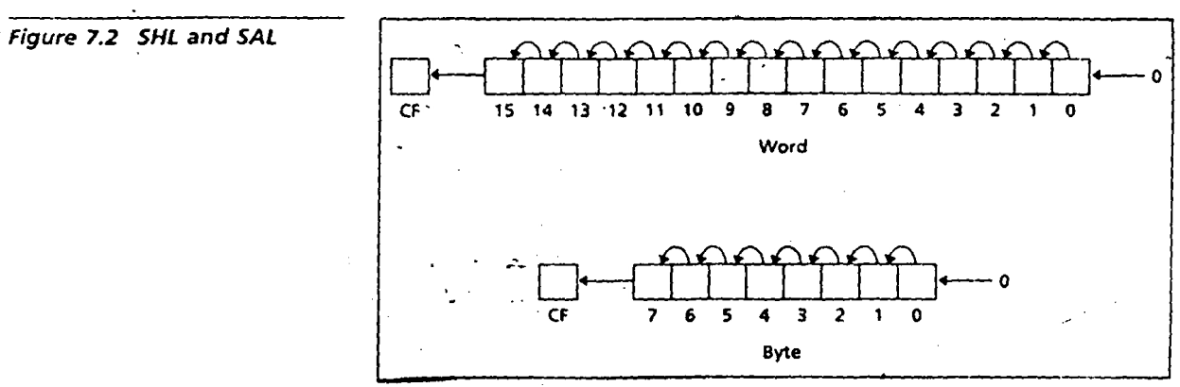
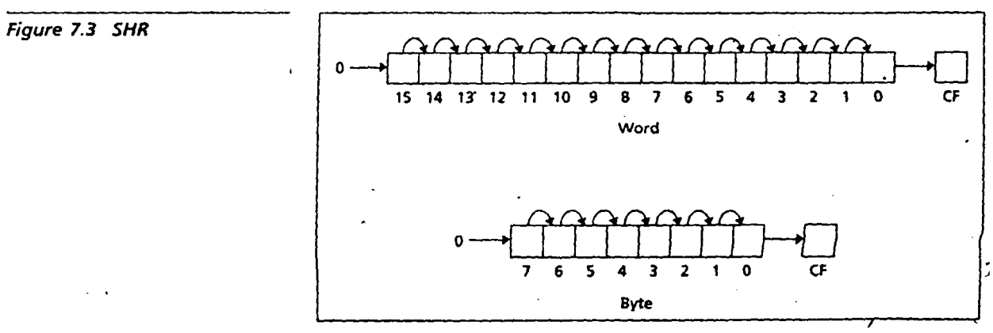

Slide 53
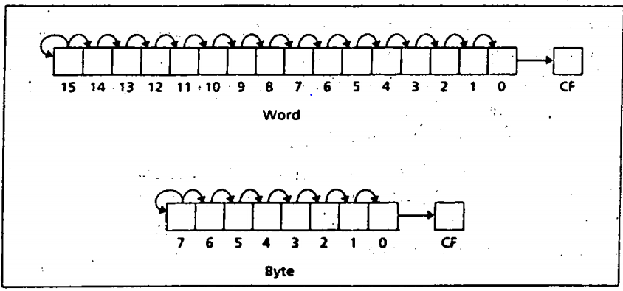

Slide 54
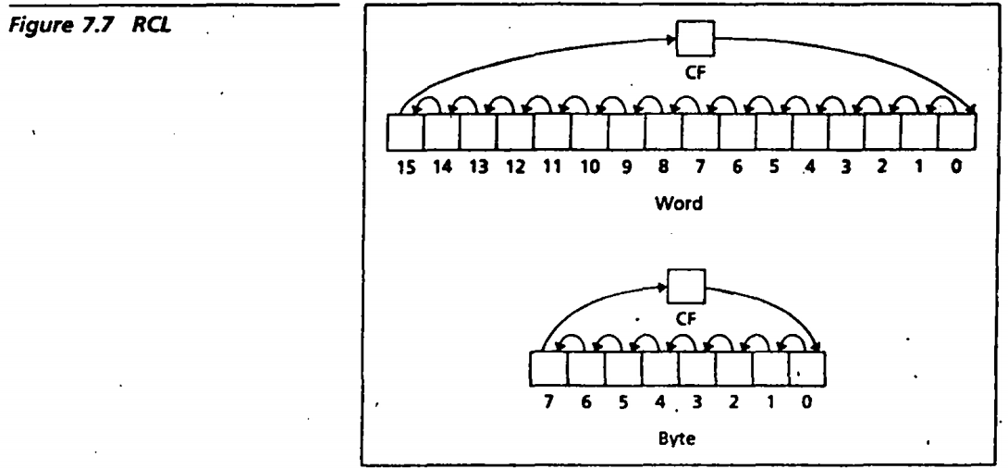
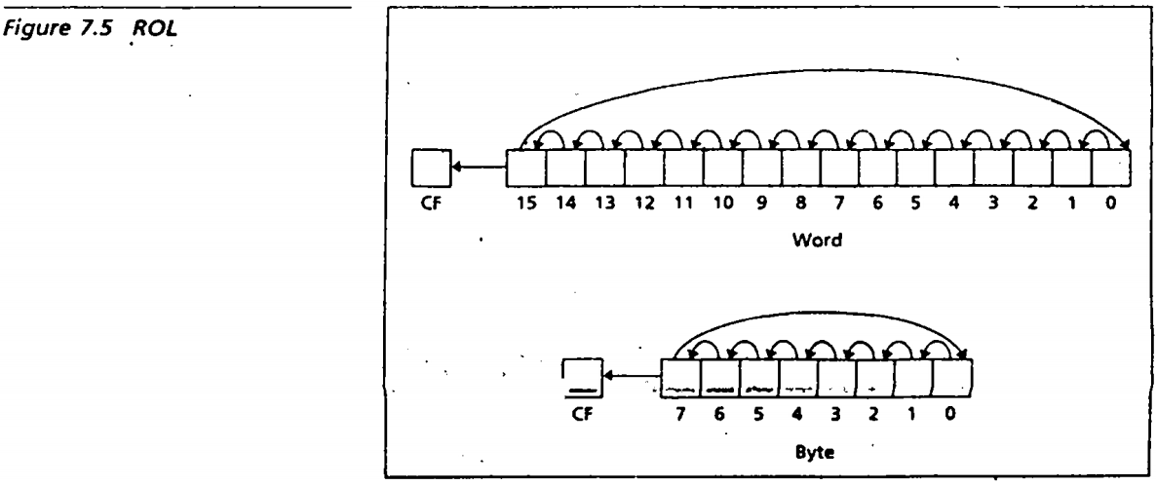

Slide 55
An example
Multiplication by 5
;Assume AX contains a number N to be multiplied by 5
MOV DX,AX ;DX=N also SHL AX,2 ;AX=4N ADD AX,DX ;AX=4N+N=5N

Slide 56
Your turn..
Reverse a bit pattern:
Input: AL=1000 0000, Output: AL=0000 0001

Slide 57
Thank You

